Slide 1
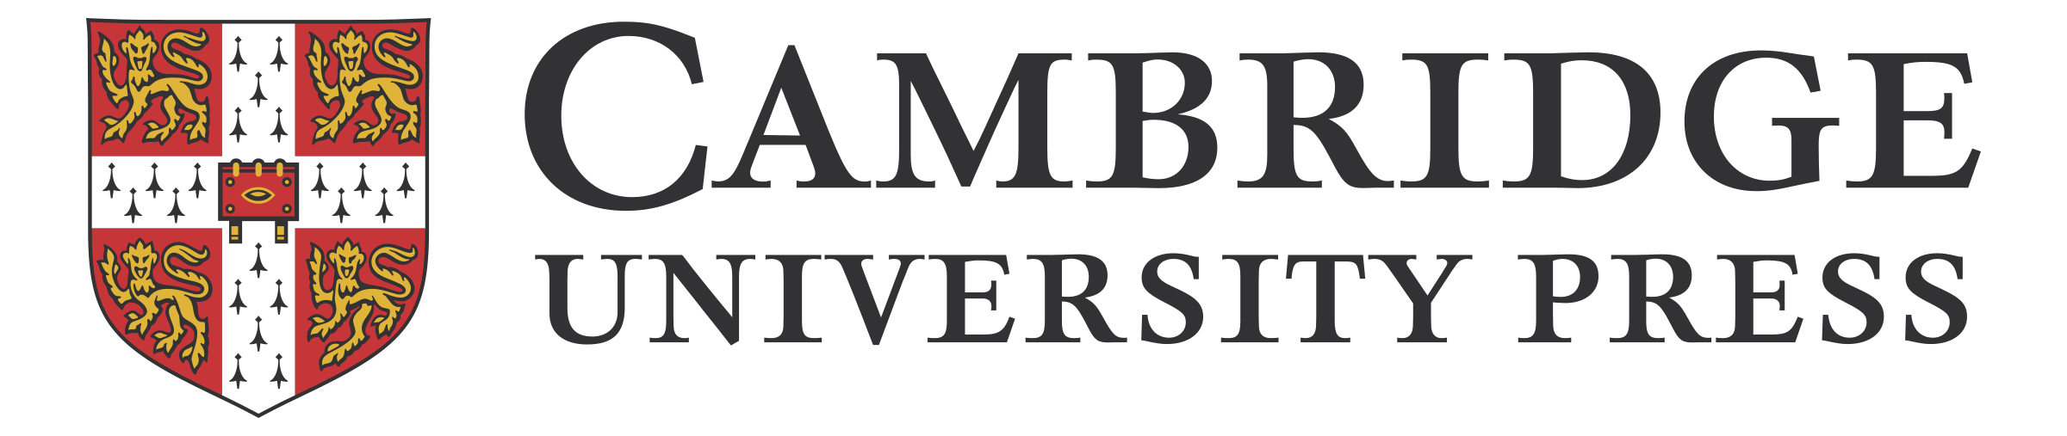

Open Research at Cambridge University Press
Informational session for MOBIUS consortium members
October 21, 2021
Savannah Lamb,
Library Sales Representative, Central & Northwest
Savannah.lamb@cambridge.org

Slide 2
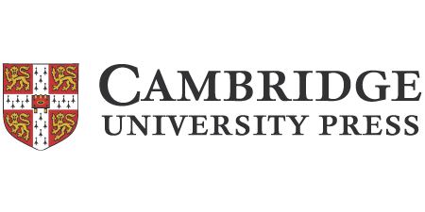



About Cambridge University Press
not-for-profit, mission-based organization & part of the University of Cambridge
oldest university press in the world – founded in 1534 by King Henry VIII
400+ journals, many in partnership with academic societies
36,000+ ebooks in wide range of subjects and focus
Mission: to publish research of the highest quality, to the broadest audience, with the maximum possible impact.

Slide 3
Open Research at Cambridge University Press
over 95% of Cambridge journals are now either hybrid or gold OA*
we have chosen the Read & Publish model (a type of transformative agreement) as our chosen vehicle of change, as it allows us to allocate revenue across journals in both STM and HSS
*A hybrid open-access journal is a subscription journal in which some of the articles are open access, a gold open access journal only includes open access publications

Slide 4
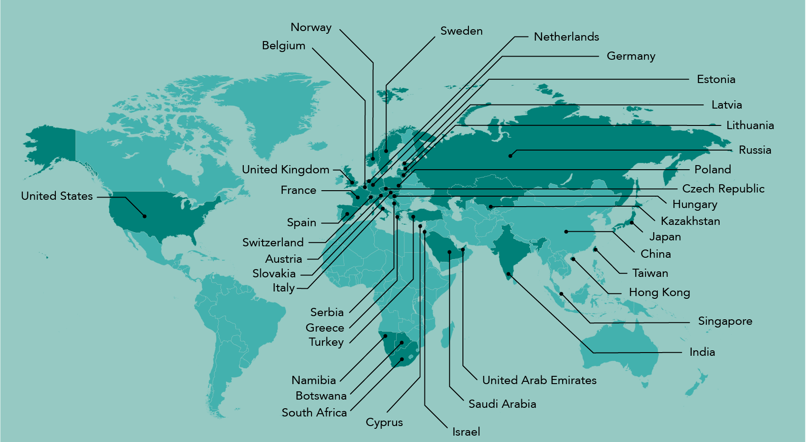
Global Read & Publish Map
2021: Almost 1,000 Customers

Slide 5
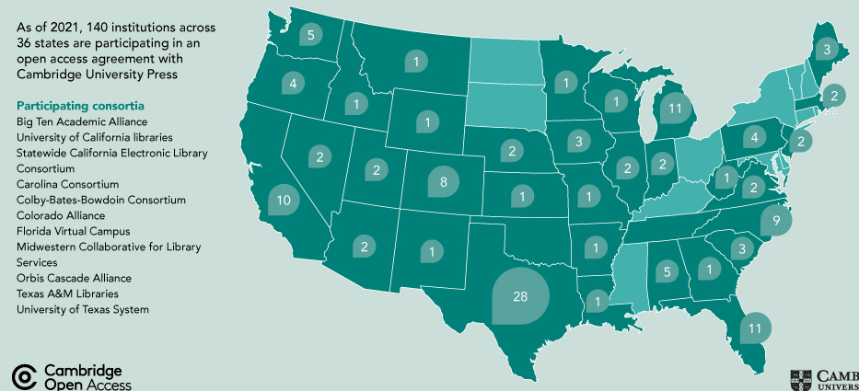
US Read & Publish Map
The Start of Our Transition
As of 2021 there are over 140 Read & Publish customers in the US

Slide 6
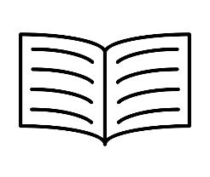
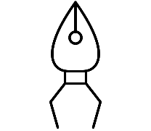
Read & Publish at CUP
The Fundamentals
Read & Publish is the combination of two services under one single agreement and cost:
We look at the balance of subscription spend against the value of your research publishing in our journals.
Read access to the subscription journals in our full journals package
Open access publishing in hybrid and gold journals in our full journals package
>
If the value of your spend exceeds the value of publishing, we offer an uncapped publishing agreement at no additional cost.
If your spend is less than your publishing value, we place a cap on publishing, or offer a top-up payment for uncapped OA.
<

Slide 7
Benefits of Read & Publish at CUP
Reading and publishing rights across our full package
Full read access to 400+ journals, combined with publishing into gold and hybrid journals within our full package.
Increased cost savings under Read & Publish:
A Read & Publish agreement allows you and your faculty to save on APC fees (an average of $2,900)
Increase the profile of your faculty research
Publishing OA secures greater reach, discoverability and higher citations for your institution’s research. OA also benefits the broader academic community.

Slide 8
Additional Subscriber Options
Benefits of upgrading to the Cambridge journals full package with read-only access:
• increased cost savings over title-by-title subscriptions
• stabilized yearly increases, more predictability for library budgets
• perpetual access rights to subscription year volumes
• substantial temporary back access included with subscription

Slide 9
What’s next?
• current publication history, subscription data, usage & turnaways reports & 2022 package pricing available by request (savannah.lamb@cambridge.org)
• more information on open research at Cambridge available on our site for reference:
https://www.cambridge.org/core/services/open-access-policies/read-and-publish-agreements
https://www.cambridge.org/core/services/authors/journals/publishing-open-access
https://www.cambridge.org/core/help/webinars-and-demos/the-read-and-publish-model

Slide 10
Questions?
Recording of webinar will be made available and distributed.
Savannah Lamb
Library Sales Representative, Central & Northwest
slamb@cambridge.org
Thank you!

